Slide 1

Smart Inventory Management System

Slide 2
Aim:
To design and develop a Smart Inventory Management System using HTML, CSS, JavaScript, Node.js, and Express.js to efficiently manage product details, maintain stock records, add new products, update product quantities, delete products, and monitor low-stock items through a user-friendly web application.
Procedure:
Step 1: Create a project folder
Create a folder named SmartInventoryManagement.
Step 2: Install the required software
Visual Studio Code
Node.js
Web browser (Chrome)
MySQL (optional, if using a permanent database)
Step 3: Create the project files
Create the following files inside the project folder:

Slide 3
</> Plain Text
SmartInventoryManagement/
server.js
package.json
public/
index.html
style.css
script.js
Step 4: Initialize the Node.js project
Open the terminal inside the project folder and execute:
</> Bash
npm init –y
npm install express
Step 5: Develop the frontend
Create an HTML page containing:
Product name
Product ID
Quantity

Slide 4
Price
Add Product button
Inventory table
Step 6:
Develop the backend
Use Node.js and Express.js to:
Add new products.
Display available products.
Update product quantities.
Delete products.
Step 7:
Connect frontend and backend
Use JavaScript Fetch API to send requests from the frontend to the Express server.
Step 8:
Execute the application
Run:
</> Bash
node server.js
Open the browser and enter:
</> Plain text
http://localhost:3000

Slide 5
Step 9: Test the application
Add products, update quantities, and delete products to verify the system.
2. Program / Source Code
A. Backend – server.js
This file handles product operations using Express.js.
</> JavaScript
const express = require("express");
const app = express();
app.use(express.json());
app.use(express.static("public"));
let products = [
{ id: 1, name: "Laptop", quantity: 10, price: 45000 },
{ id: 2, name: "Mouse", quantity: 25, price: 500 },
{ id: 3, name: "Keyboard", quantity: 15, price: 1000 }
];
// Display all products
app.get("/products", (req, res) => {
res.json(products);
});
// Add a new product
app.post("/products", (req, res) => {
const { name, quantity, price } = req.body;
if (!name || Numberqua (ntity) < 0 ||
!Number.isFinite(Number(quantity)) ||
!Number.isFinite(Number(price)) ||

Slide 6
Number(price) < 0) {
return res.status(400).json({ message: "Invalid product details" });
}
const product = {
id: products.length
? Math.max(...products.map(p => p.id)) + 1 : 1,
name,
quantity: Number(quantity),
price: Number(price)
};
products.push(product);
res.json({ message: "Product added successfully", product });
});
app.put("/products/:id", (req, res) => {
const product = products.find(
p => p.id === Number(req.params.id)
);
if (!product) {
return res.status(404).json({ message: "Product not found" });
}
const quantity = Number(req.body.quantity);
if (!Number.isInteger(quantity) || quantity < 0) {
return res.status(400).json({ message: "Invalid quantity" });
}
product.quantity = quantity;
res.json({ message: "Stock updated successfully", product });
});
// Delete product
app.delete("/products/:id", (req, res) => {
const oldLength = products.length;
products = products.filter(
p => p.id !== Number(req.params.id)
);
if (products.length === oldLength) {

Slide 7
return res.status(404).json({ message: "Product not found" });
}
res.json({ message: "Product deleted successfully" });
});
app.listen(3000, () => {
console.log("Server running at http://localhost:3000");
});
B. Frontend – public/index.html
</> HTML
<!DOCTYPE html>
<html>
<head>
<title>Smart Inventory Management</title>
<link rel="stylesheet" href="style.css">
</head>
<body>
<h1>Smart Inventory Management System</h1>
<div class="container">
<h2>Add New Product</h2>
<input type="text" id="name"
placeholder="Product Name">
<input type="number" id="quantity"
placeholder="Quantity" min="0">
<input type="number" id="price"
placeholder="Price" min="0" step="0.01">
<button onclick="addProduct()">Add Product</button>
</div>
<h2>Inventory Details</h2>

Slide 8
<table>
<thead>
<tr>
<th>ID</th>
<th>Product Name</th>
<th>Quantity</th>
<th>Price (Rs.)</th>
<th>Stock Status</th>
<th>Action</th>
</tr>
</thead>
<tbody id="productList"></tbody>
</table>
<script src="script.js"></script>
</body>
</html>
C. CSS – public/style.css
body {
font-family: Arial, sans-serif;
background: #f2f2f2;
text-align: center;
padding: 20px;
}
h1 {
color: #234;
}
.container {
background: white;
padding: 20px;
margin: 20px auto;
width: 80%;
border-radius: 10px;
}
input {
padding: 10px;
margin: 8px;
width: 180px;

Slide 9
}
button {
padding: 10px 15px;
background: #16834a;
color: white;
border: none;
cursor: pointer;
border-radius: 5px;
}
table {
width: 90%;
margin: auto;
border-collapse: collapse;
background: white;
}
th, td {
padding: 12px;
border: 1px solid #ccc;
}
th {
background: #234;
color: white;
}
.low {
color: red;
font-weight: bold;
}
.available {
color: green;
font-weight: bold;
}
.delete {
background: red;
}

Slide 10
D. JavaScript – public/script.js
</> JavaScript
async function loadProducts() {
const response = await fetch("/products");
const products = await response.json();
const list = document.getElementById("productList");
list.innerHTML = "";
products.forEach(p => {
const status = p.quantity <= 5
? "Low Stock" : "Available";
const row = document.createElement("tr");
[
p.id,
p.name,
p.quantity,
p.price,
status
].forEach((value, index) => {
const cell = document.createElement("td");
cell.textContent = value;
if (index === 4) {
cell.className = p.quantity <= 5
? "low" : "available";
}
row.appendChild(cell);
});
const action = document.createElement("td");
const updateBtn = document.createElement("button");

Slide 11
updateBtn.textContent = "Update";
updateBtn.onclick = () => updateProduct(p.id);
const deleteBtn = document.createElement("button");
deleteBtn.textContent = "Delete";
deleteBtn.className = "delete";
deleteBtn.onclick = () => deleteProduct(p.id);
action.append(updateBtn, deleteBtn);
row.appendChild(action);
list.appendChild(row);
});
}
async function addProduct() {
const name = document.getElementById("name").value.trim();
const quantity = document.getElementById("quantity").value;
const price = document.getElementById("price").value;
if (!name || quantity === "" || price === "" ||
Number(quantity) < 0 || Number(price) < 0) {
alert("Enter valid product details");
return;
}
const response = await fetch("/products", {
method: "POST",
headers: { "Content-Type": "application/json" },
body: JSON.stringify({ name, quantity, price })
});
const result = await response.json();
alert(result.message);
if (response.ok) loadProducts();
}
async function deleteProduct(id) {
if (!confirm("Are you sure you want to delete?")) return;
const response = await fetch("/products/" + id, {
method: "DELETE"
});

Slide 12
const result = await response.json();
alert(result.message);
loadProducts();
}
loadProducts();
Expected Output
Output 1: Server running
When you execute node server.js, the terminal displays:
</> Plain Text
Server running at http://localhost:3000
Output 2: Home page

Slide 13
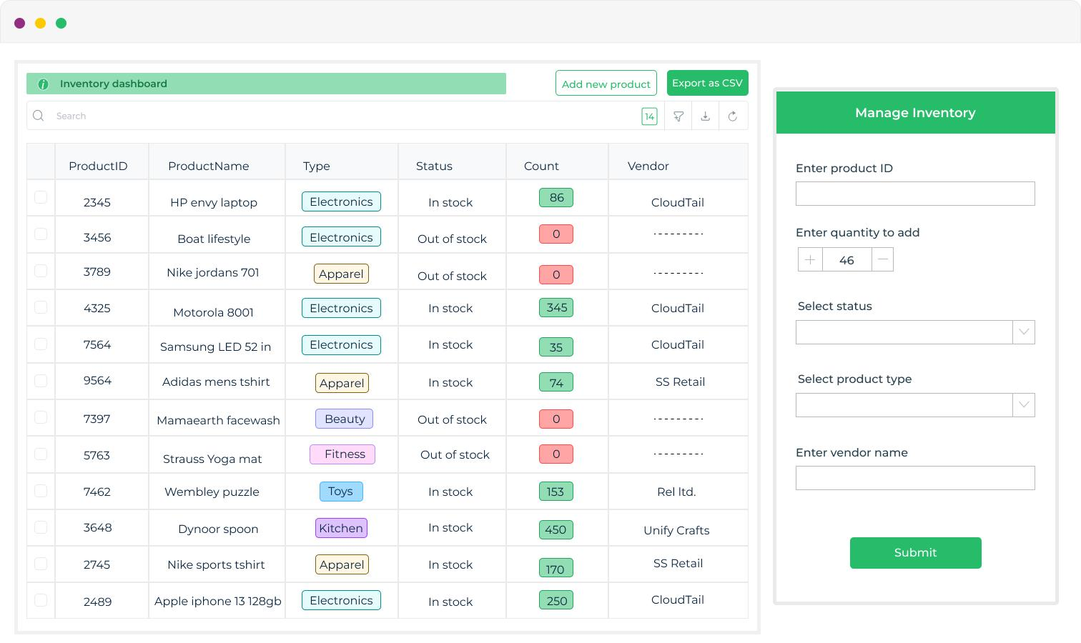

Slide 14
Output 3: Inventory details
The browser displays the following sample inventory:
ID | Product Name | Quantity | Price (₹) | Status
1 | Laptop | 10 | 45000 | Available
2 | Mouse | 25 | 500 | Available
3 | Keyboard | 15 | 1000 | Available
Output 4: Adding a product
Enter the following details:

Slide 15
</> Plain Text
Product Name: Monitor
Quantity: 4
Price: 8000
Click Add Product.
Expected message:
</> Plain text
Product added successfully
Updated inventory:
ID | Product Name | Quantity | Price | Status
1 | Laptop | 10 | 45000 | Available
2 | Mouse | 25 | 500 | Available
3 | Keyboard | 15 | 1000 | Available
4 | Monitor | 4 | 8000 | Low Stock

Slide 16
Output 5: Updating stock
When you click Update for Monitor and enter 20:
</> Plain Text
Stock updated successfully
The status changes to Available.
Output 6: Deleting a product
When you click Delete:
</> Plain Text
Product deleted successfully
The selected product is removed from the inventory table.
Result
Thus, the Smart Inventory Management System was successfully developed using HTML, CSS, JavaScript, Node.js, and Express.js. The application allows users to add, view, update, and delete products and monitor low-stock items efficiently.

Slide 17


